Slide 1
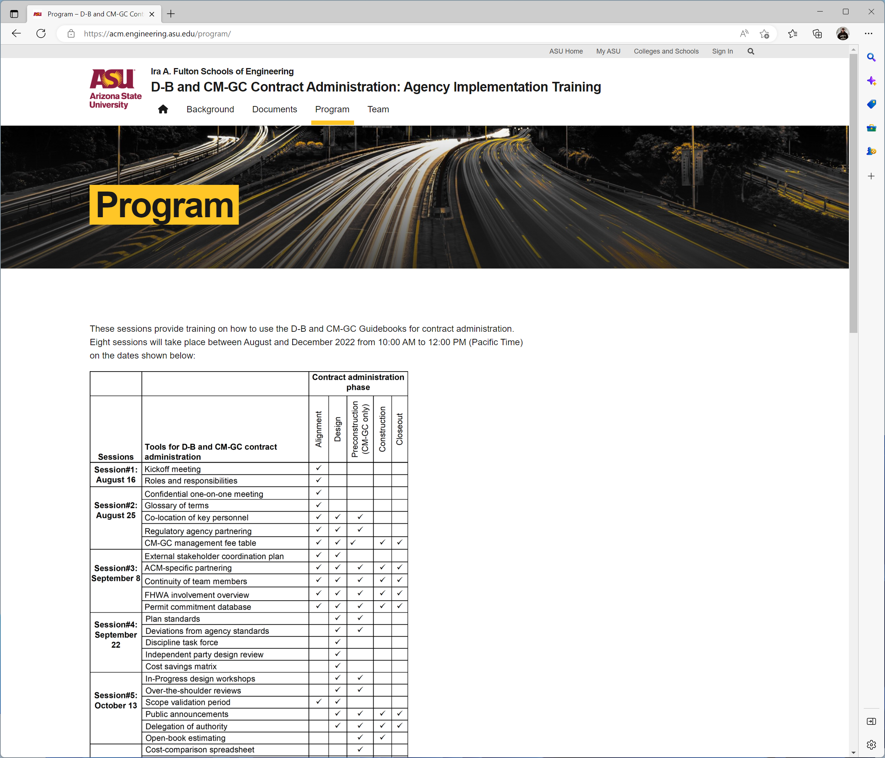


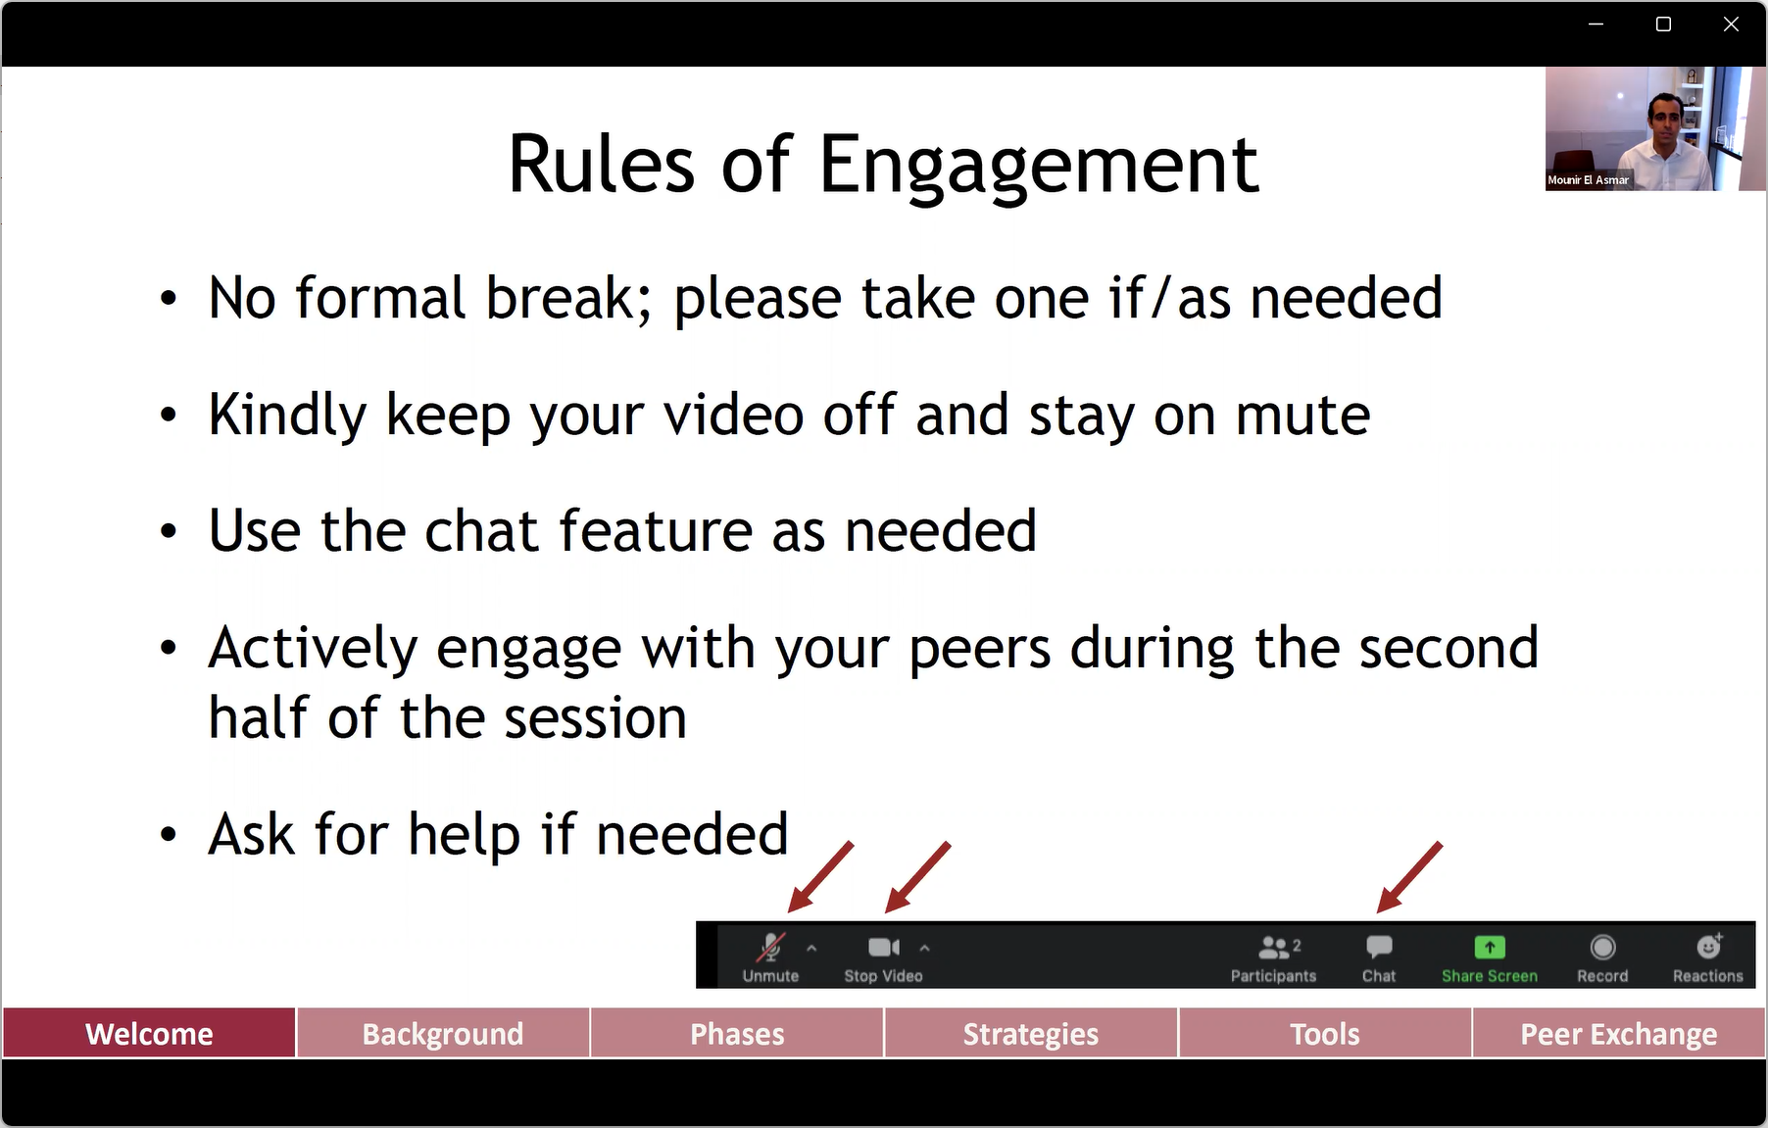
Template Idea
Header
Contextual Menu
Body
Include:
Video (Hosted outside WP)
PDF of Presentation
Link to Report
Docs and Images (if Apply)
Useful Links
Session 1 (2)
Welcome
Background
Strategies
Phases
Tool 1
Tool 2
Peer Exchange
Session 2 (6)
Session 3 (6)
Session 4 (x)
Session 5 (x)
Session 6 (x)
Session 7 (x)
Session 8 (2)
Group 1 selected
=> Show link for Tool 1 -> 4
Group 2 -> X. Unselected
Group X (Y)
Group “x” has “y” Tools

Slide 2
Request
New template, based on “Default Template”, adding a side menu (Group of Pages)
This set of pages must be password protected (not open to the public)
Side menu 1 -> Tool Page (Group 1)
Welcome
Background
Strategies
Phases
Tool 1
Tool 2
Peer Exchange
Side menu 2 -> Tool Page (Group 2)
Tool 5
Tool 6
Tool 7
Tool 8
Etc.
OBS: I tried to create a template (ToolMenu1, but the header is missing and the ToolMenu too). I am not able to remove old templates and/or fix the ToolMenu1 – Template).

